Slide 1
Boston Crime Data Analysis & Visualisation
Group 5
Dipti Bhattad
Shruthi Subbaiah Machimada

Slide 2
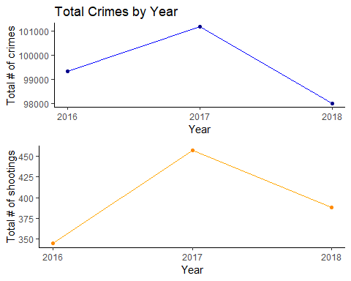
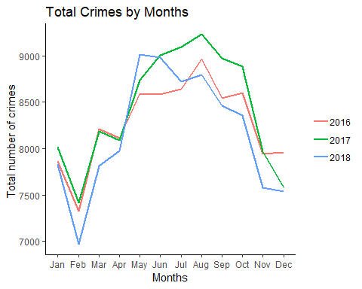
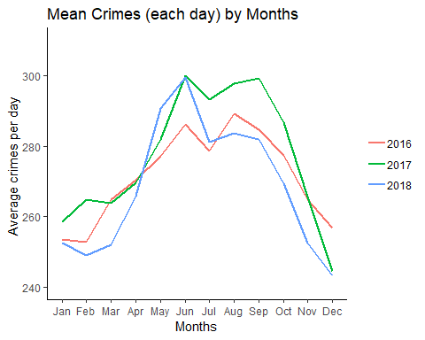

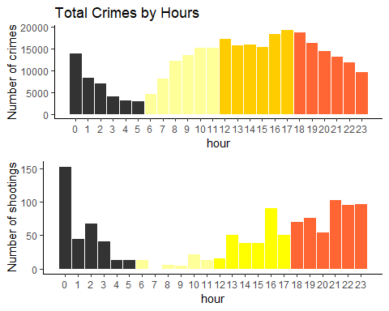
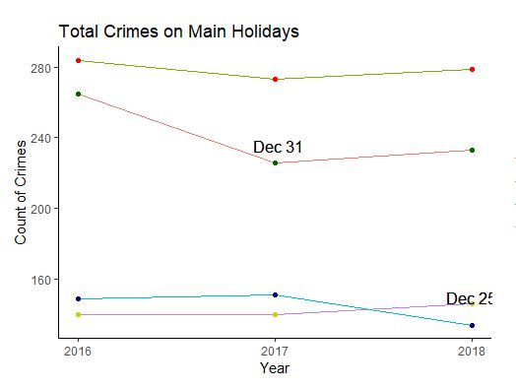
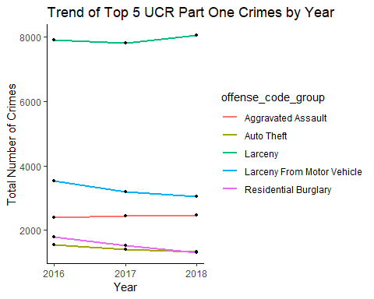
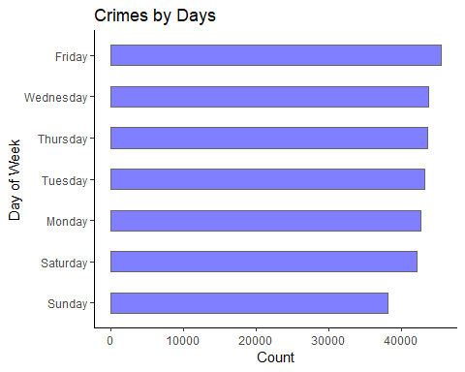
Do you know
Time Series Analysis of Boston Crime from 2016-2018
On an average, 272 crimes are reported every single day in Boston
4th July
Thanksgiving

Slide 3
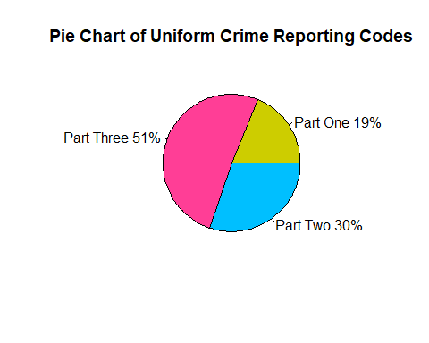
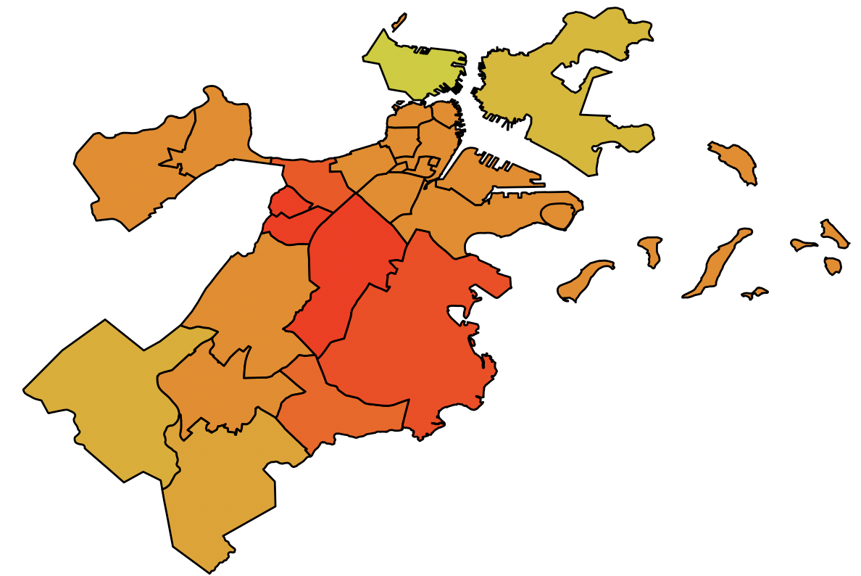
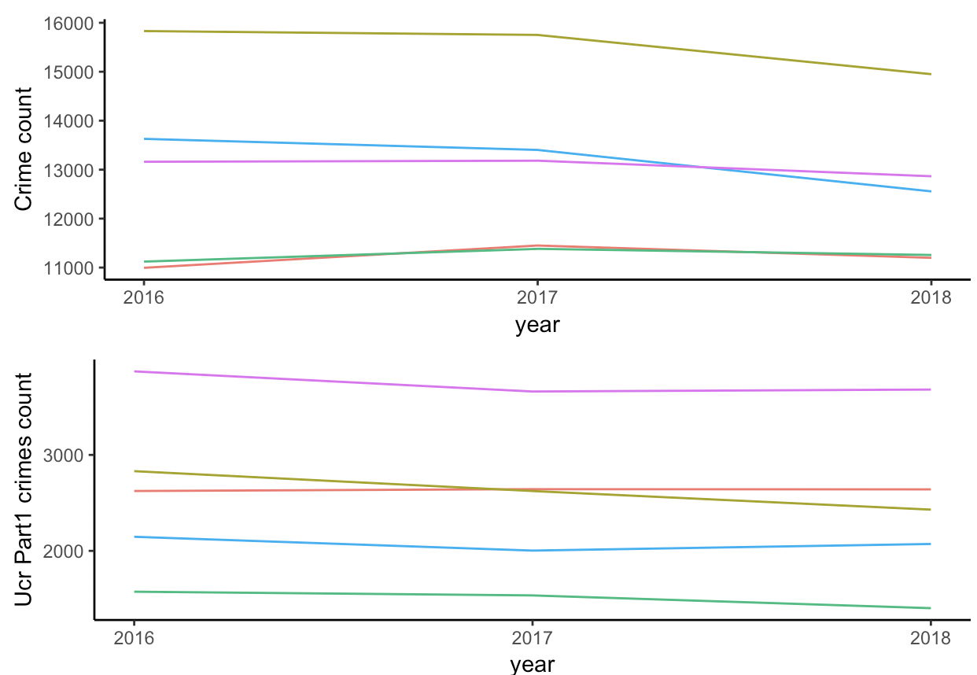
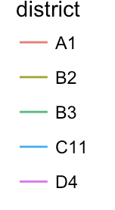
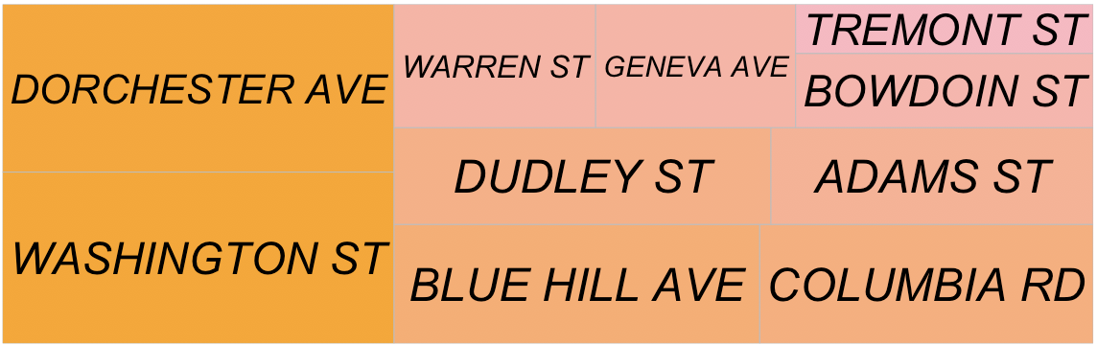
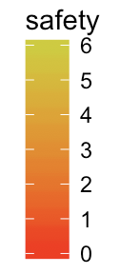
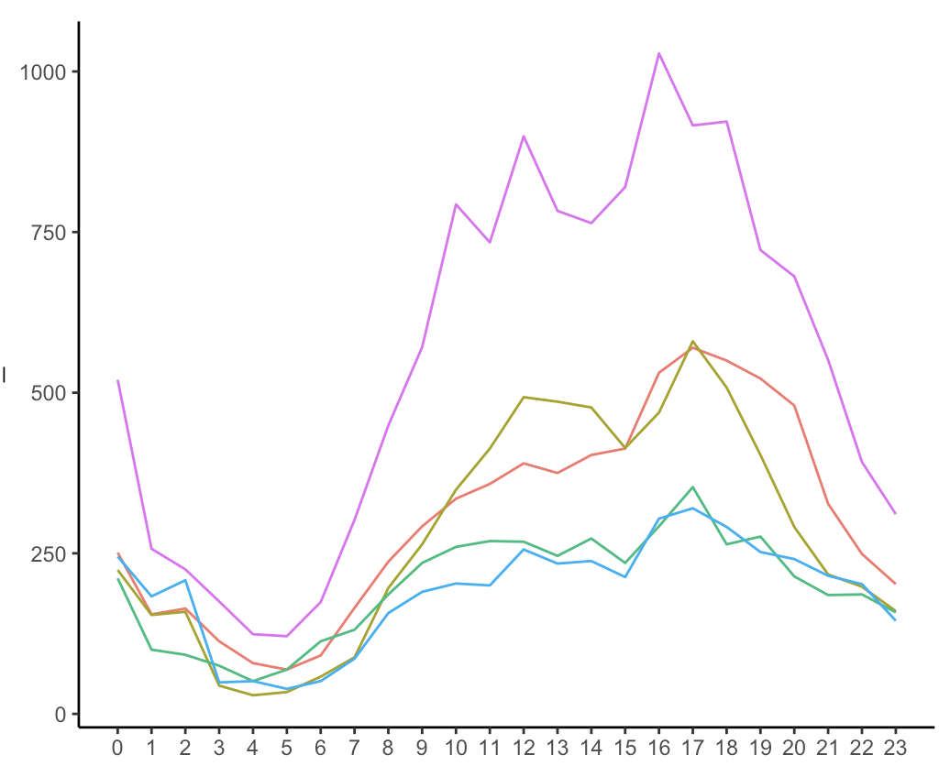
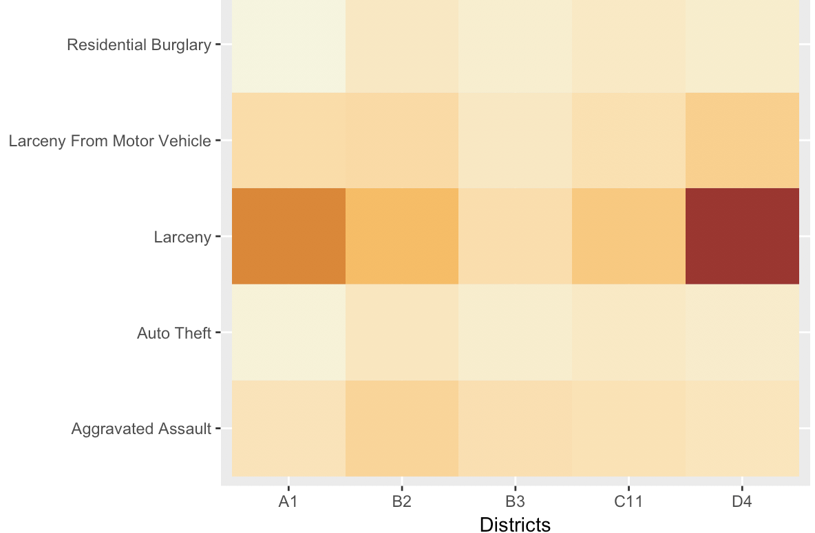
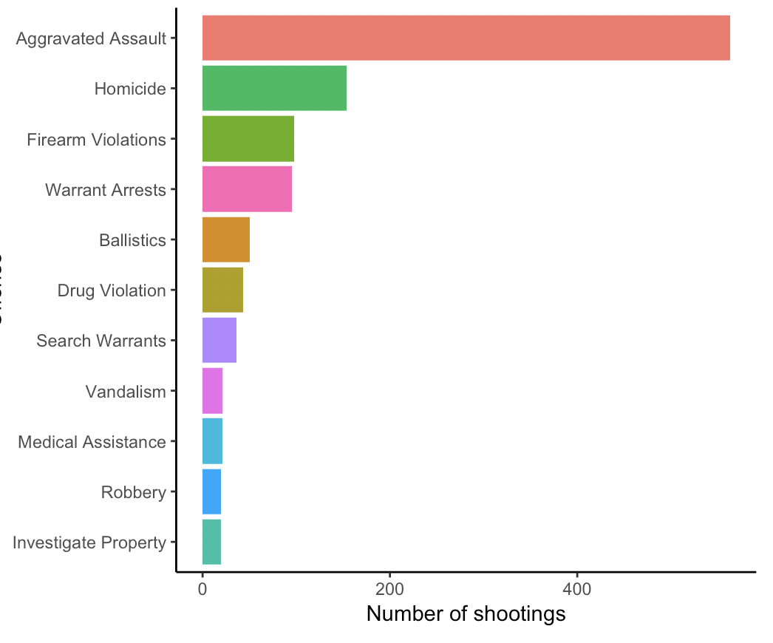
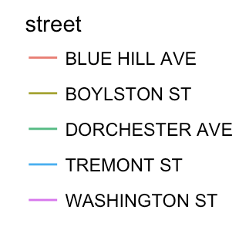
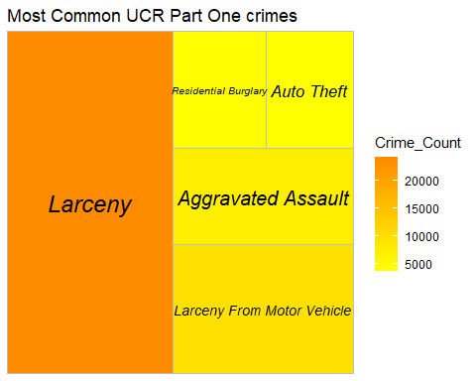
Most populated: Dorchester, Roxbury
Most crimes: Roxbury, Dorchester
Most shootings: Roxbury, Mattapan
Most UCR 1 crimes: Fenway, BackBay, Central
Safe districts: Charleston, East Boston
Analysis of Crime across districts in Boston
Has the safety of districts changed?
Unsafe streets in Dorchester & Roxbury
Daily crime pattern in streets
UCR Part1 crimes and their distribution across districts
Crimes that involved shooting

